Slide 1

Development of Science and Technology

Slide 2
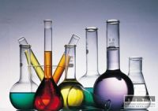
Science
from Latin: scientia = knowledge
an enterprise that builds and organizes knowledge in the form of testable explanations and predictions

Slide 3
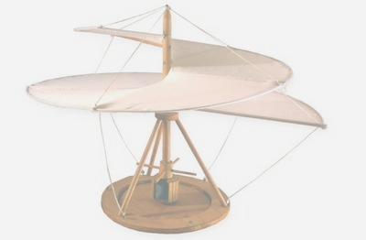
Technology
from Greek τεχνολογία (technología)
from τέχνη (téchnē)= art, skill, craft
and -λογία (-logía)= study of-
the creation, usage and knowledge of tools, techniques, crafts, systems or methods of organization as means in order to solve a problem or serve some purpose

Slide 4
Vocabulary
Invent/ discover/ create/ produce/ observe/ dissect/ analyze
Innovation/ discovery/ invention/ experiment/ observation/ patent/ theory/ hypothesis/ record
Computer age/ addiction/ misuse/ information technology/ gadget/ electricity/ artificial/ genuine/ harmful/ useful/
CLICK HERE test you vocabulary to test you science and technology vocabulary
Scientific branches:
Biology, chemistry,

Slide 5
Scientific branches
Anatomy: the study of the structure and organization of living things
Anthropology: the study of human cultures both past and present
Archaeology: the study of the material remains of cultures
Astronomy: the study of celestial objects in the universe
Biology: the science that studies living organisms
Botany: the scientific study of plant life
Chemistry: the science of matter and its interactions with energy and itself
Ecology: the study of how organisms interact with each other and their environment
Electronics: science and technology of electronic phenomena
Engineering: the practical application of science to commerce or industry
Geology: the science of the Earth, its structure, and history
Mathematics: a science dealing with the logic of quantity and shape and arrangement
Medicine: the science concerned with maintaining health and restoring it by treating disease
Physics: the study of the behavior and properties of matter
Zoology: the study of animals

Slide 6


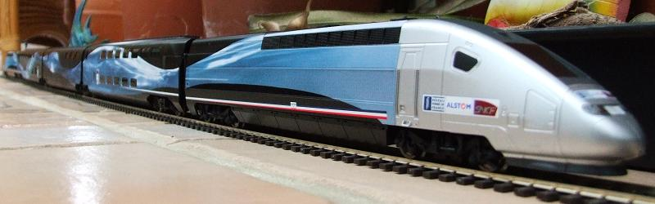
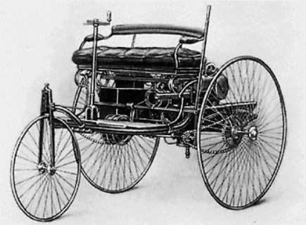
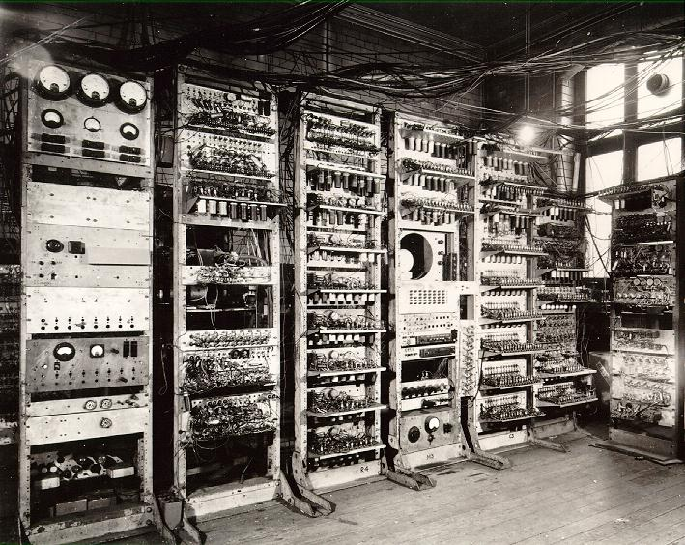
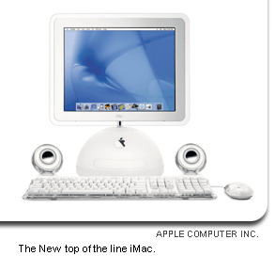
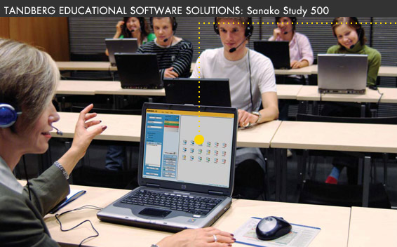
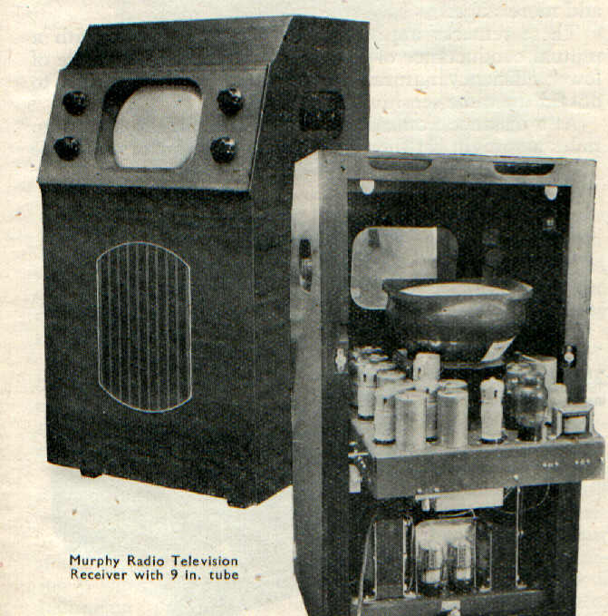
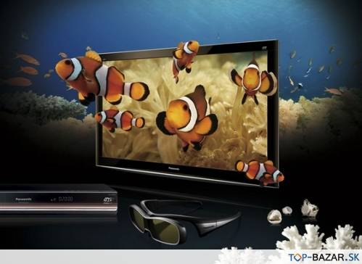
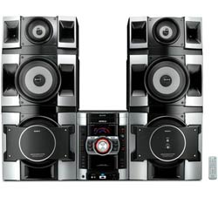
Past vs. present
Travelling
Education
Entertainment

Slide 7
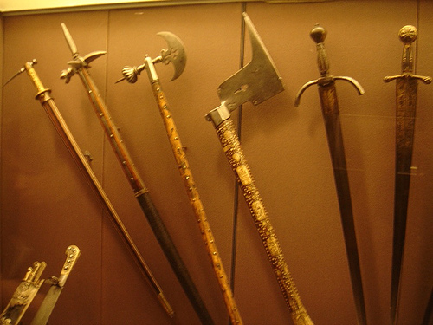

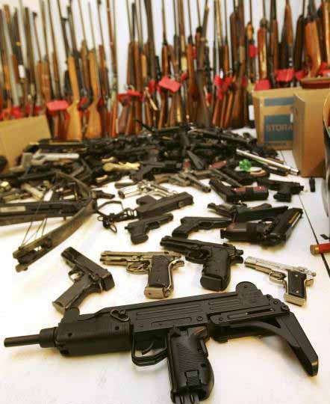
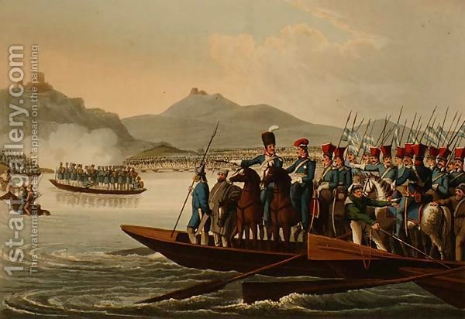
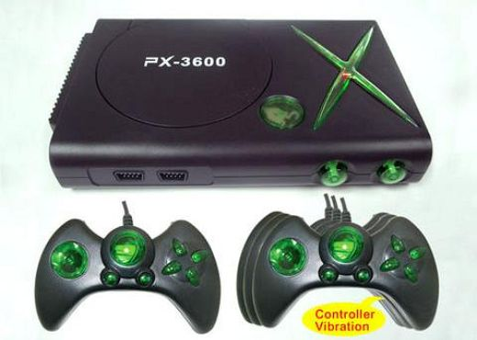
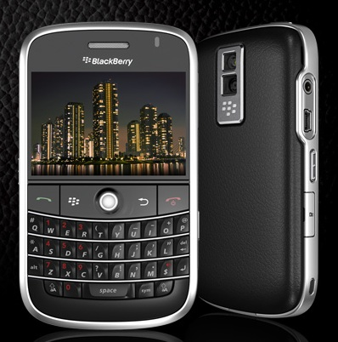
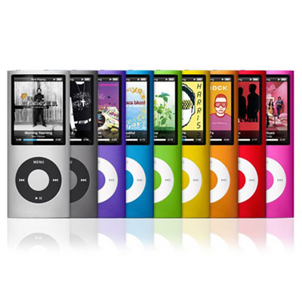
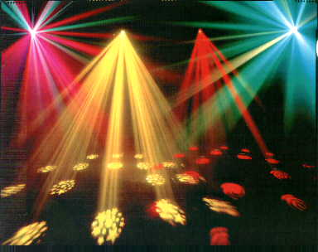
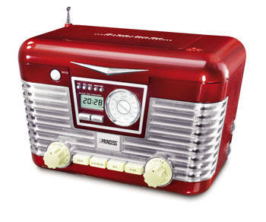
Past vs. present
Army
Entertainment

Slide 8
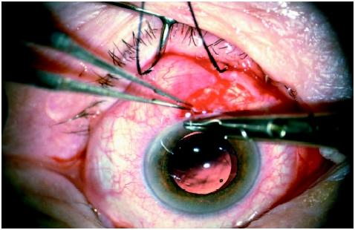
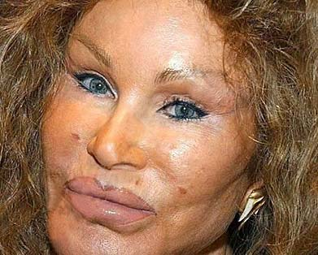
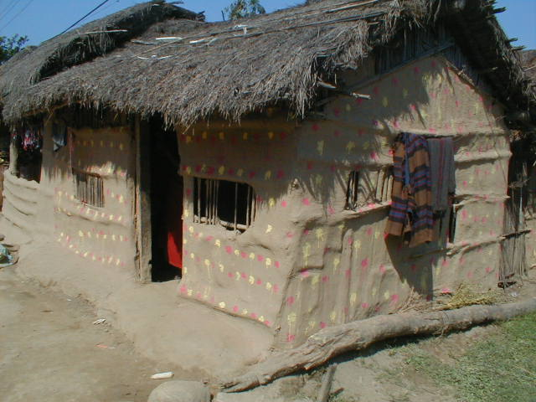
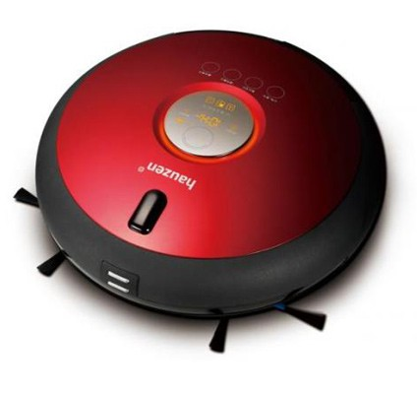

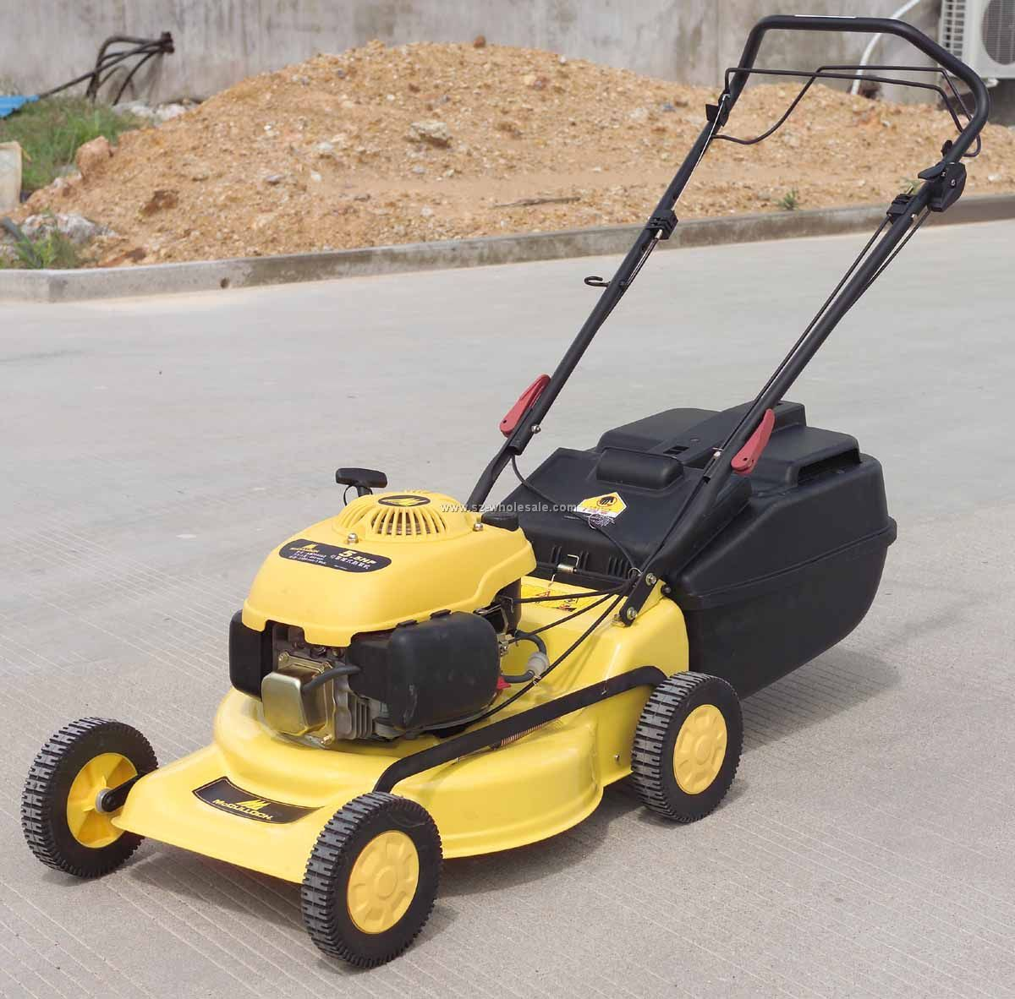
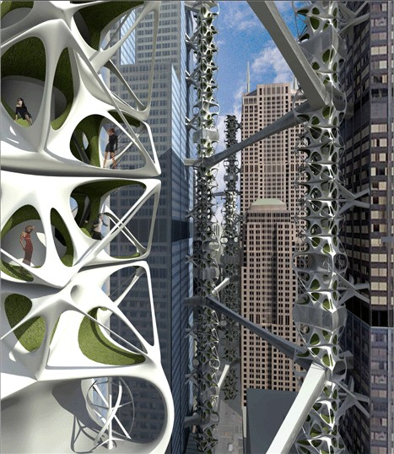
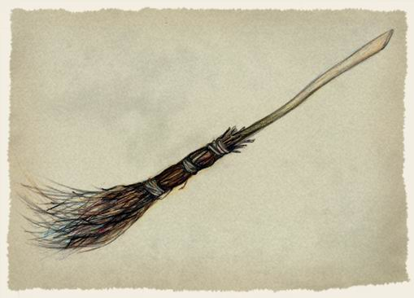
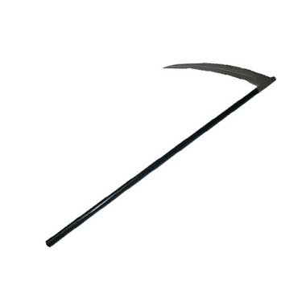
Past vs. present
Medicine
Housing

Slide 9
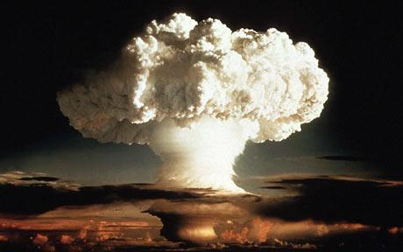
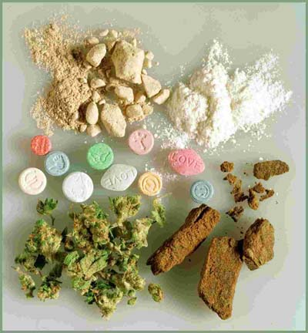

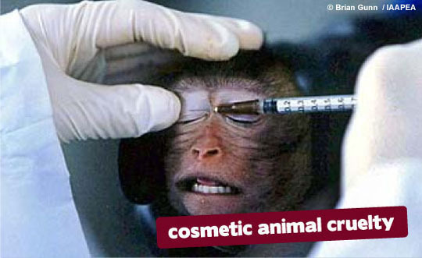
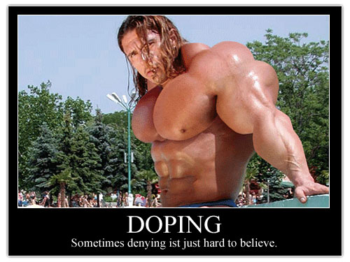
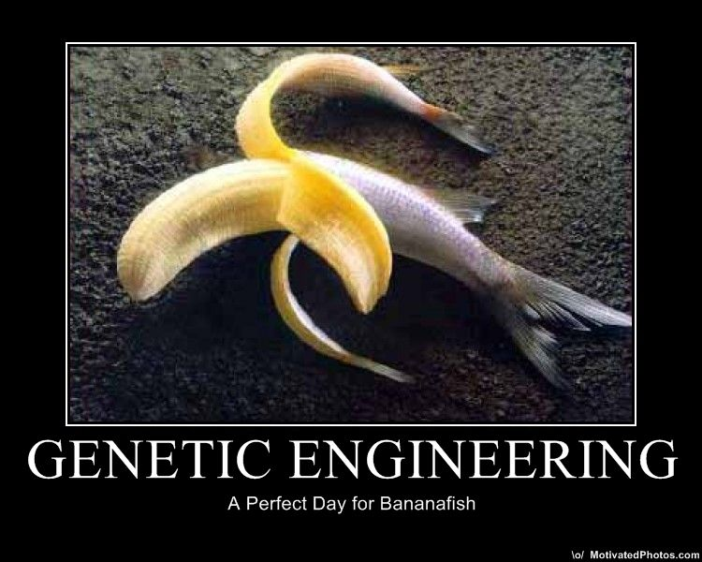
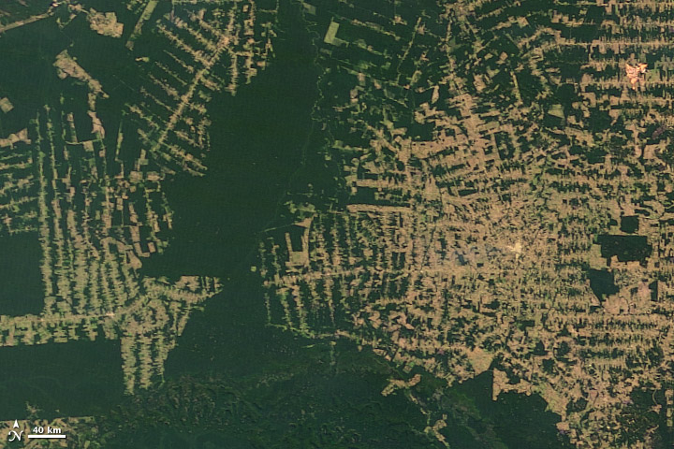
Misuse of scientific discoveries describe the pictures and mention the side-effects of scientific discoveries

Slide 10
The greatest scientific discoveries
Anesthesia - the term itself was created by Oliver Wendell Holmes in 1846, poppy seeds were used as a type of anesthesia back in pre-historic times. There are many different types of anesthesia, including herbal anesthesia.
DNA - Deoxyribonucleic Acid, or the mapping of the human gene, 1953 James Watson and Francis Crick
Electricity – June 1752, Benjamin Franklin (kite)
Fingerprints – 1823 when Jan Evangelista Purkinje noticed how unique our fingerprints are

Slide 11
Light Bulb -1879, Thomas Edison
Computer - In 1936, the Z1 computer was created and is often credited as being the first computer
Eniac - Electronic Numerical Integrator And Computer – 1946
Penicillin - 1940s Dr. Alexander Fleming accidentaly
Radio Waves
Hubble’s Telescope
Invisible Cloak - The studies look at ways to make light bend around an object, so that it no longer appears to be visible.

Slide 12
Questions:
What do you think will be the greatest discovery of the 21st century?
Do you think time travelling will be discovered?
Try to imagine your life without electricity. Do you think you would manage?
Describe the term Age of Information.
Which jobs might disappear in the future?
Would you like to be taught at home by a computer?
Do you think people should be allowed to clone people or organs of people?
What do you think about GMO (genetically modified organisms)?
What social changes have cell phones made?
Do you remember any interesting, fun or dangerous lab experiments that you did at school?
Do you think couples should be allowed to choose the sex or other characteristics of their baby like eye color?
Do you feel comfortable with the idea of Artificial Intelligence (that robots can think)?

